Slide 1
TI Training Learnings
Samir Paul
A0507124
May 15 – May 26

Slide 2

Unix: Commands link
ls lists files folders
ls –l lists files in the 'long format'
ls –a lists all files, including the ones whose filenames begin in a dot
mv filename1 filename2 move filename1 to filename2
cp filename1 filename2 copy
rm filename removes a file. rm –i asks for confirmation before deleting
diff filename1 filename2 compares files
wc filename count of lines, words, charecters
chmod options filename chmod o+r filename readable for everyone, chmod o-r filename unreadable for others again
gzip filename compresses files
gunzip filename uncompresses files compressed by gzip
gzcat filename look at a gzipped file without gunzip it

Slide 3
mkdir dirname
cd dirname
pwd
ff --- find files anywhere on the system
grep string filename
who
whoami
ps -u username
kill PID
touch creates empty file
rm filename
sort filename print list in lexicographical order
man command_name provides reference on commands
clear
history

Slide 4
chmod [options] [mode] [File_name]
chmod [options] [mode] [File_name]
groups shows the groups I have membership
chmod [options] [mode] [File_name] Learn more
chown change file/directory ownership Learn more
cat>filename create a file with some contents
Cat filename open a file in notepad
Head Print first 10 lines
Tail
wget – download files from remote servers, HTTP/HTTPS and FTP
set: to check details.
Echo string eg. echo “Samir is an intern at TI” prints this string
x = 10
echo the value of x is $x

Slide 5
alias unalias
set unset
ls all ls commands: tutorialspoint.com/unix_commands/ls.htm
gvim
More all more commands: ibm.com/docs/en/aix/7.2?topic=m-more-command
w --- tells who's logged in, and what they're doing
All Unix commands of training: https://github.com/samirti/unix/raw/main/unix-training.docx

Slide 6
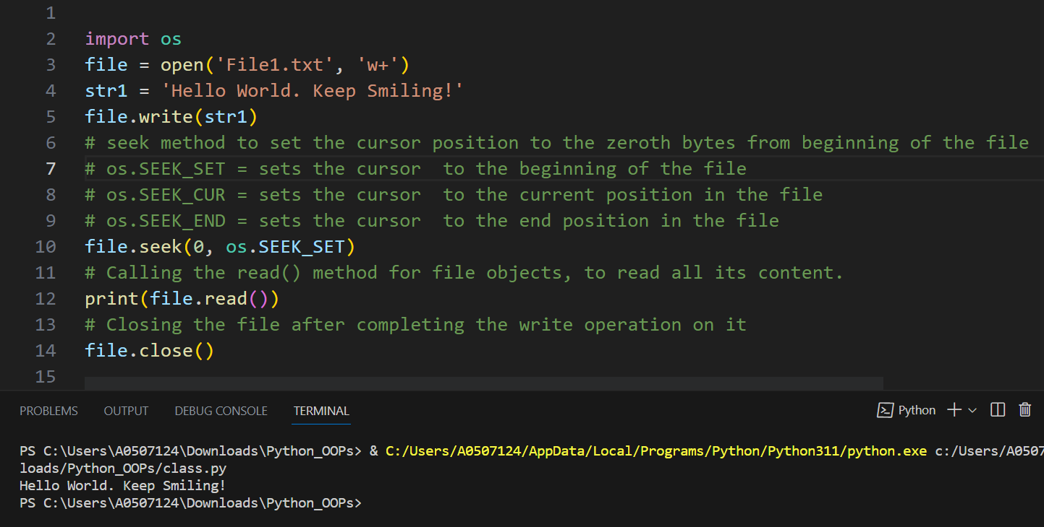
Python:
Modifying a File on the Disk:
w+ mode to modify the file

Slide 7
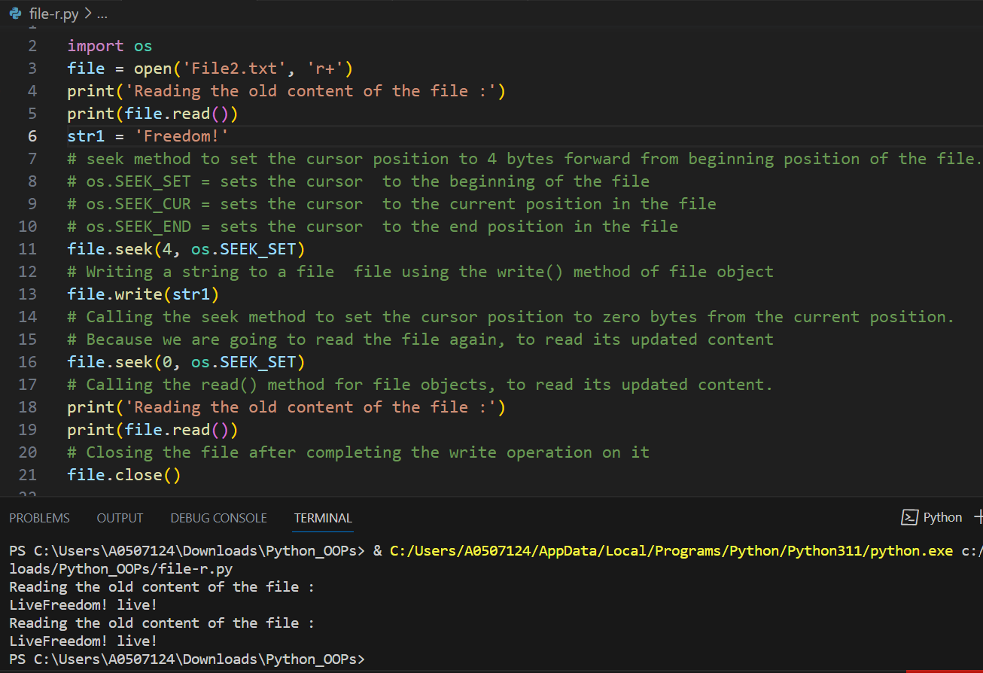
r+ mode to modify the file

Slide 8
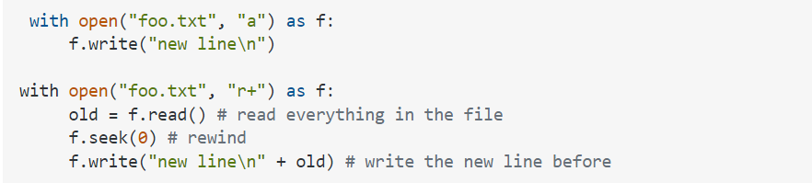
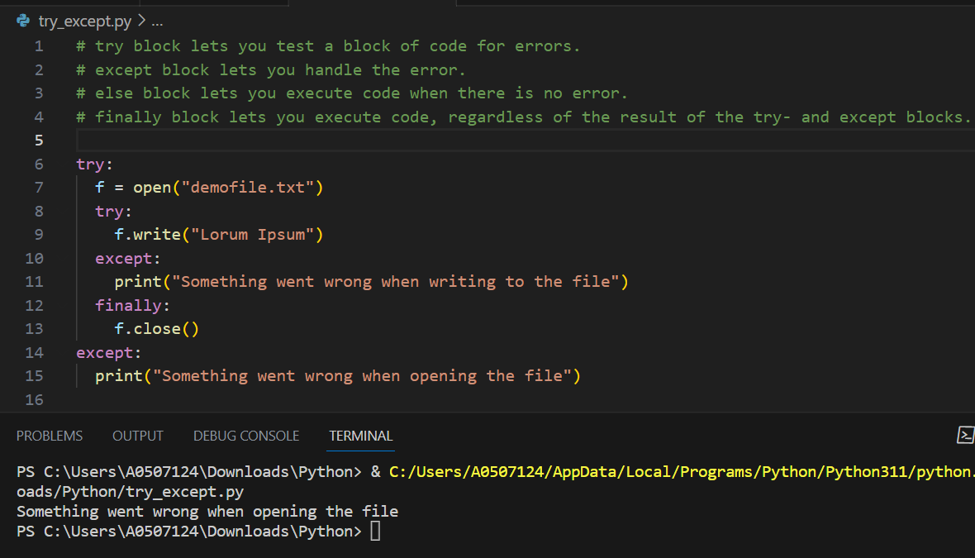
Try Except

Slide 9
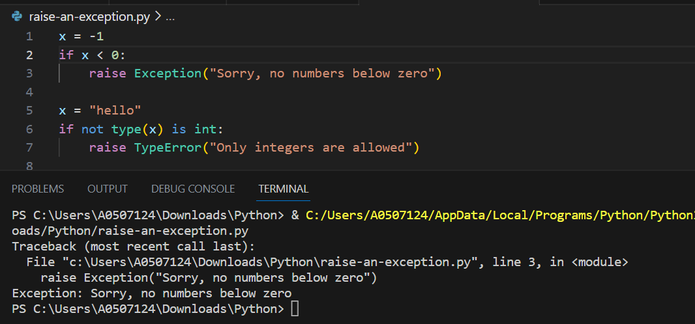
Raise an exception

Slide 10
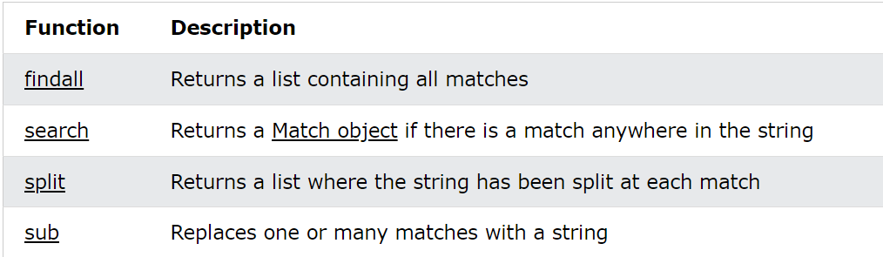
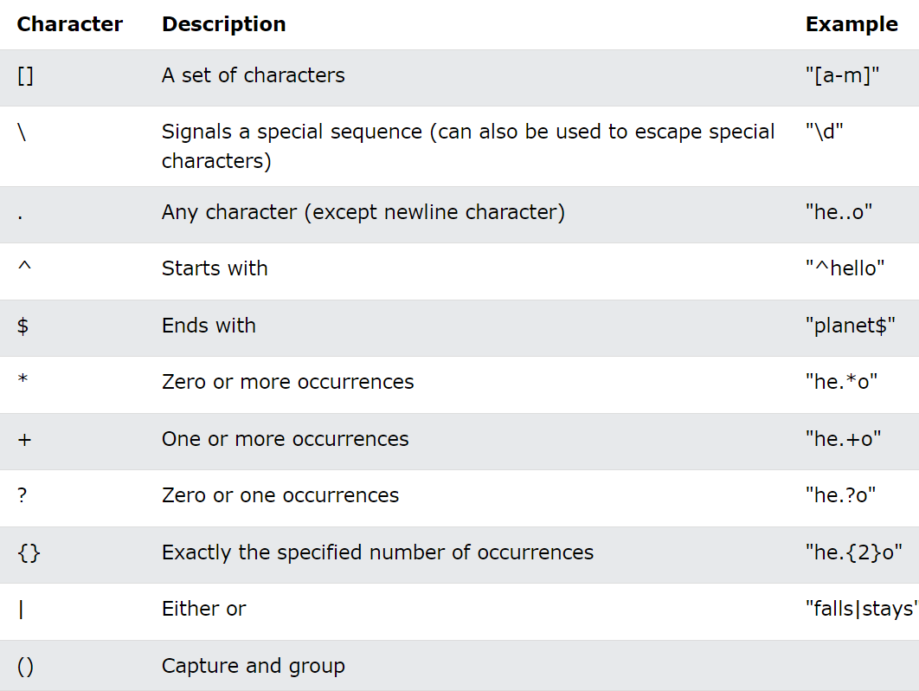
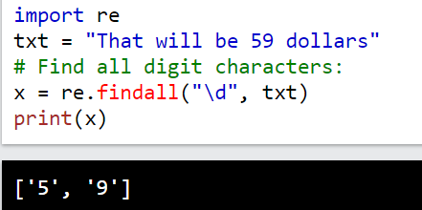
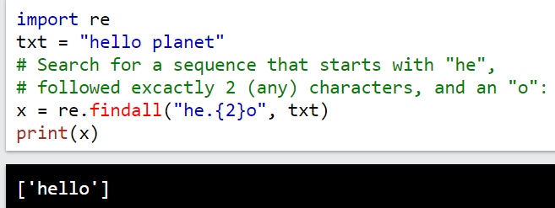
RegEx Module

Slide 11
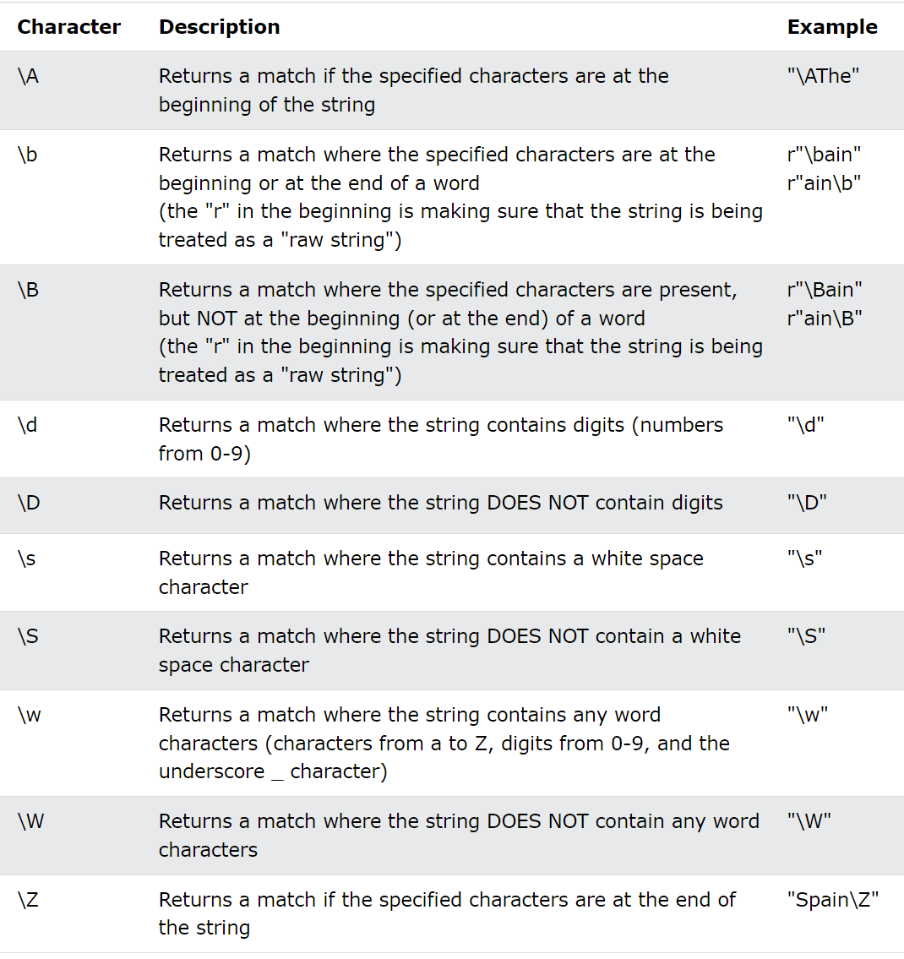
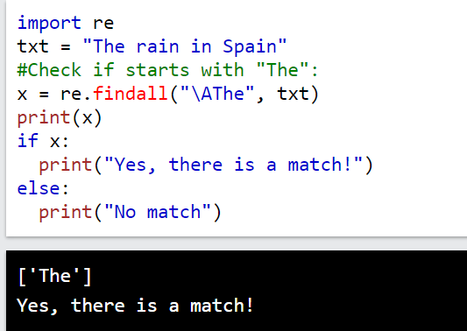
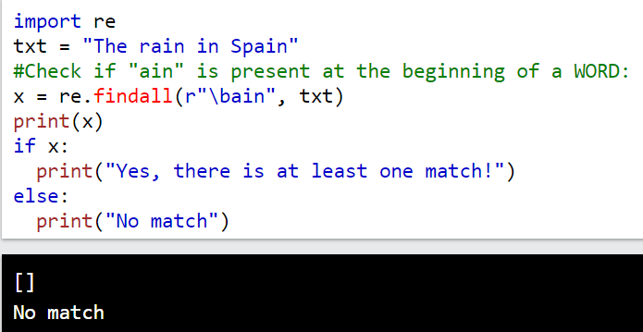
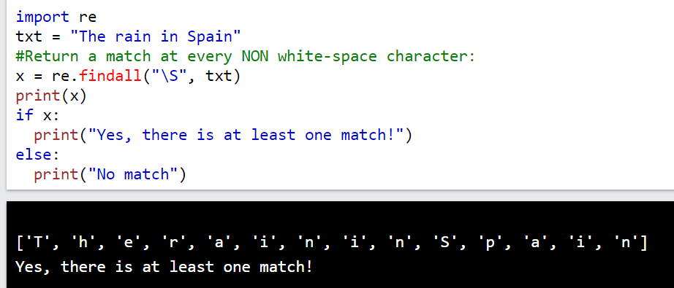

Slide 12
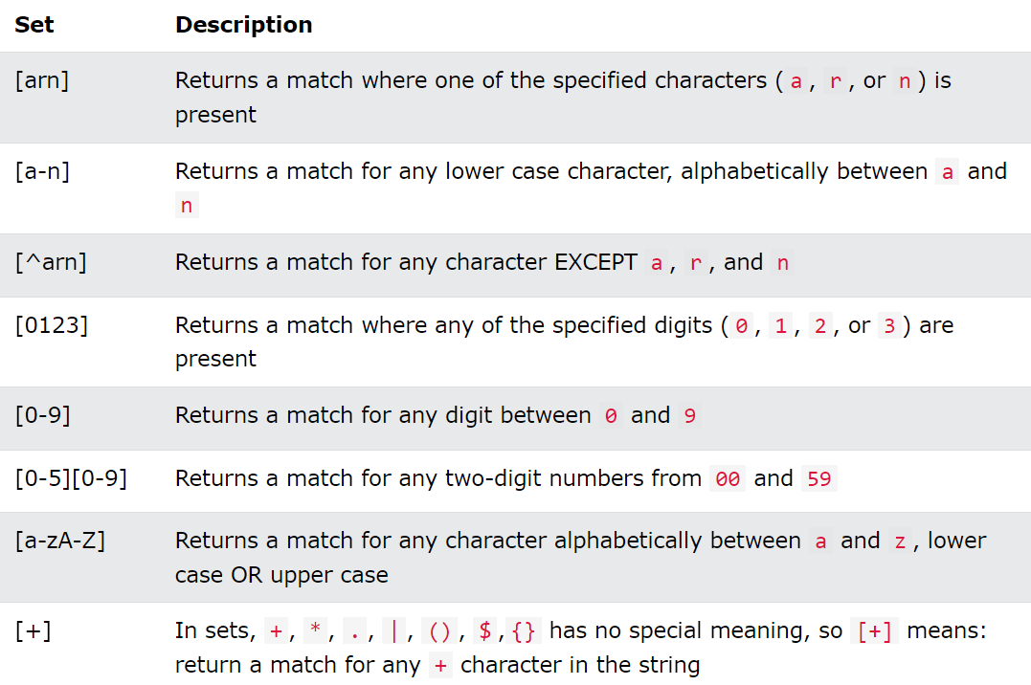
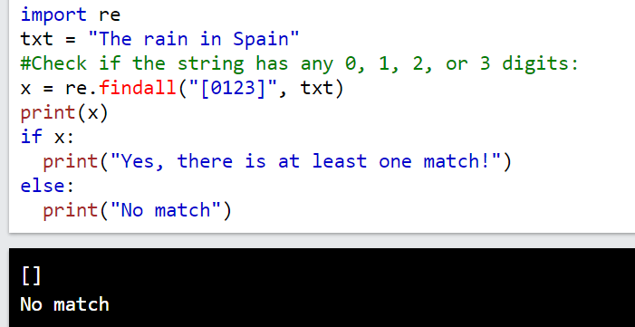
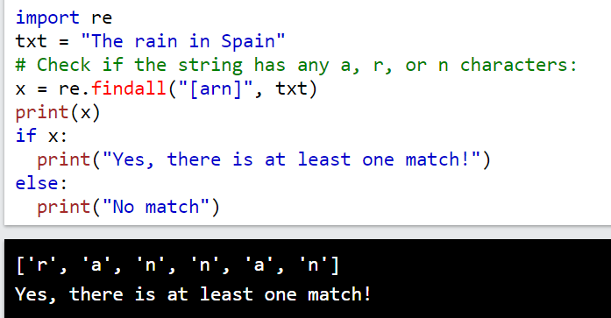
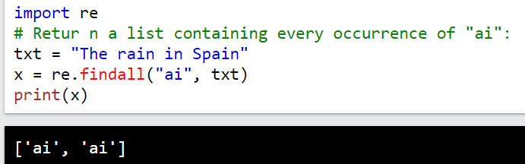
findall() Function

Slide 13
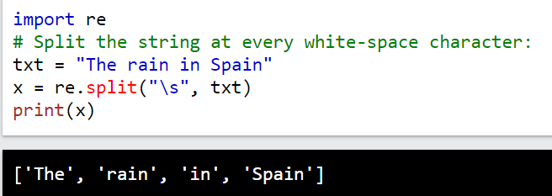
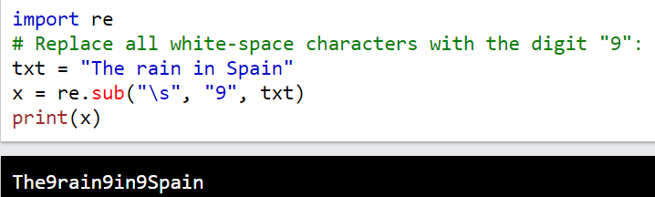
split() Function
sub() Function

Slide 14
Python Object-Oriented Programming
Python Object Oriented Programming by Joe Marini course
C:\Users\A0507124\Downloads\Python_Object_Oriented_Programming
https://github.com/samirti/python/raw/main/Python_Object_Oriented_Programming.zip

Slide 15
What is Functional Safety?
Functional safety is about reducing the risks of simple and complex systems, such that they function safely in the event there is an electrical or electronic malfunction. It is very important to implement functional safety to microelectronics and software into their design at the system level.
Why functional safety is important?
Functional safety is important because it ensures that systems are designed to be safe and reliable. It is a part of the overall safety of a system or piece of equipment that depends on automatic protection. This automatic protection system needs to respond correctly to its inputs and should have predictable responses to failure. This includes human errors, hardware failures, and operational/environmental stress.
At its core, functional safety is important because its sole purpose is to protect users from harm. Complex technology is an integral part of our day-to-day activities, and we demand that they are safe to use. It is becoming an important aspect of consumers’ purchase decisions.

Slide 16
ISO 26262 Functional Safety Standard
ISO 26262 addresses the need for an automotive-specific international standard that focuses on safety-critical components.
ISO 26262 is a derivative of IEC 61508, the generic functional safety standard for electrical and electronic (E/E) systems.
ISO 26262 uses a system of steps to manage functional safety and regulate product development on a system, hardware, and software level. It details how to assign an acceptable risk level to a system or component and documents the overall testing process.
Key Components:
Automotive Safety Lifecycle(management, development, production, operation, service, decommissioning).
Automotive Safety Integrity Levels, ASILs (specific risk-based approach for determining risk classes)

Slide 17
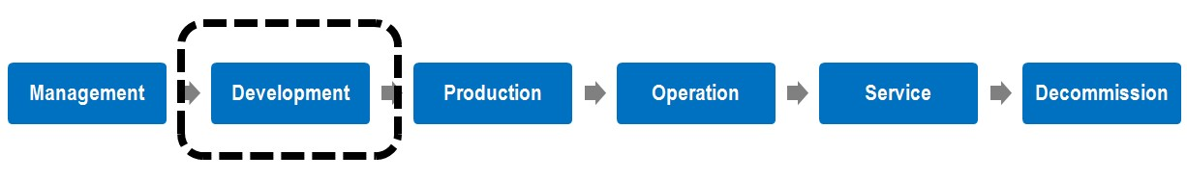
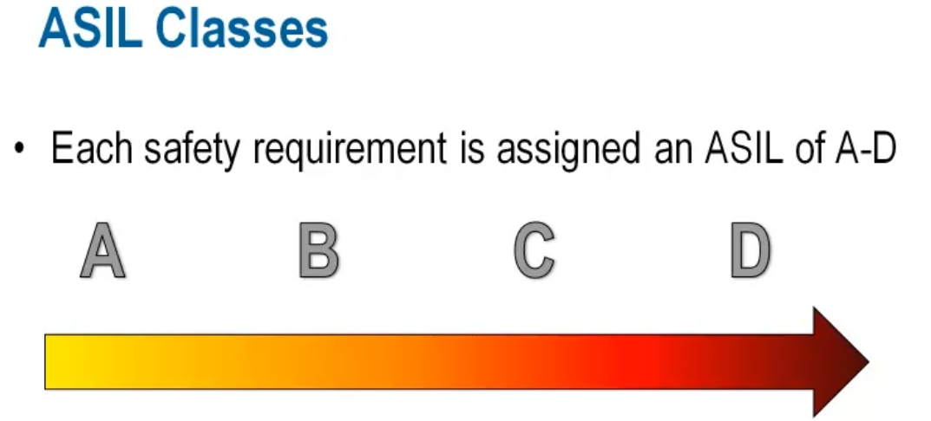
Automotive Safety Lifecycle
The ISO 26262 automotive safety lifecycle describes the entire production lifecycle.
Automotive Safety Integrity Level (ASIL)
Automotive-specific approach for assigning risk levels. ASIL does not address the technologies
Used in the system it’s totally on the harm to the driver and other road users.
least safety most safety

Slide 18
Use of Functional Safety
Functional Safety is a critical aspect of automotive design and manufacture. The Automotive Safety Integrity Level (ASIL) is a risk classification scheme defined by the Automotive Functional Safety Standards Standard ISO 26262. ASILs establish safety requirements based on the probability and acceptability of harm for automotive components to be compliant with ISO 26262. ASIL-D is an automotive risk classification that is part of a larger ISO standard – ISO 26262 – which looks at functional safety.
Here are some uses of Functional Safety for all ASILs:
ASIL A: Components like rear lights require only an ASIL-A grade.
ASIL B: Components like headlights and brake lights generally require an ASIL-B grade.
ASIL C: Components like cruise control generally require an ASIL-C grade.
ASIL D: Systems like airbags, anti-lock brakes, and power steering require an ASIL-D grade, which is the highest rigor applied to safety assurance because the risks associated with their failure are the highest.

Slide 19
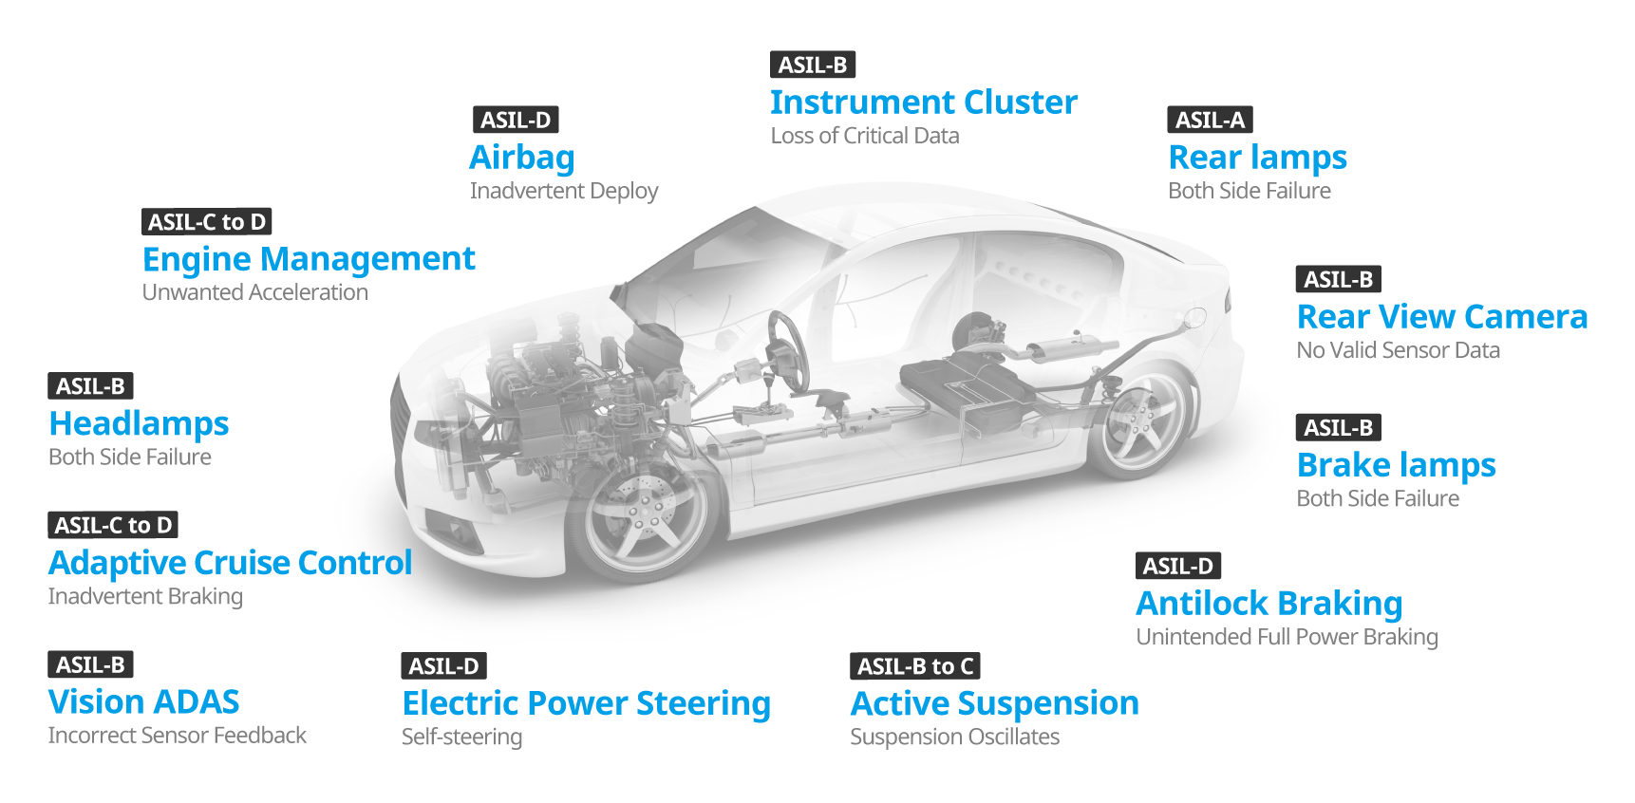
ASIL - A, B, C, and D in car components

Slide 20
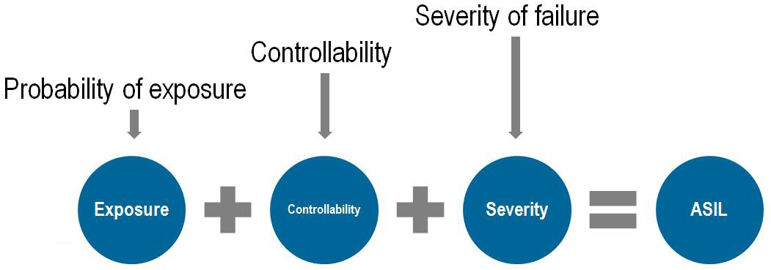
Qualification of Hardware Components
Hardware qualification has two main objectives: to show how the part fits into the overall system and to assess failure modes.
Basic Parts: Resistors and Diodes.
Intermediate parts or components: Sensors, Actuators, and ASICs with dedicated functionality.
Complex components: Microprocessor, Microcontroller, DSP, and accelerator.
Qualification of Software Components
Qualifying software components involves activities such as defining functional requirements, resource usage, and predicting software behavior in failure and overload situations. Software errors such as runtime and data errors are analyzed and addressed throughout the design process.

Slide 21
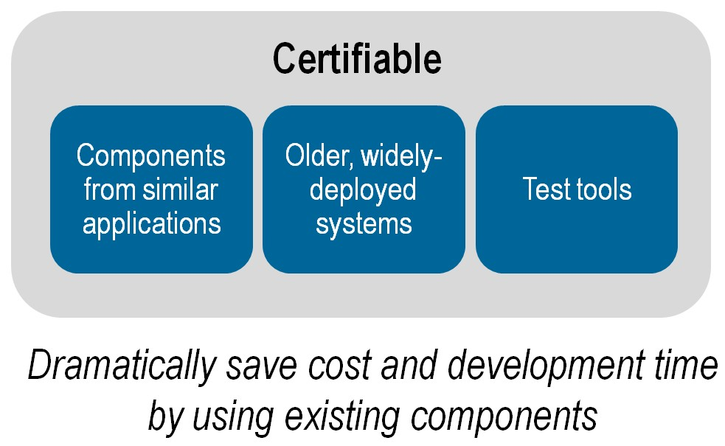
Reliable systems that remain unchanged and have been used for a long time are certifiable with ISO 26262. The combination of certifiable components from similar applications and from older, widely-deployed applications greatly reduces the overall system complexity. We can use those components to save costs.

Slide 22
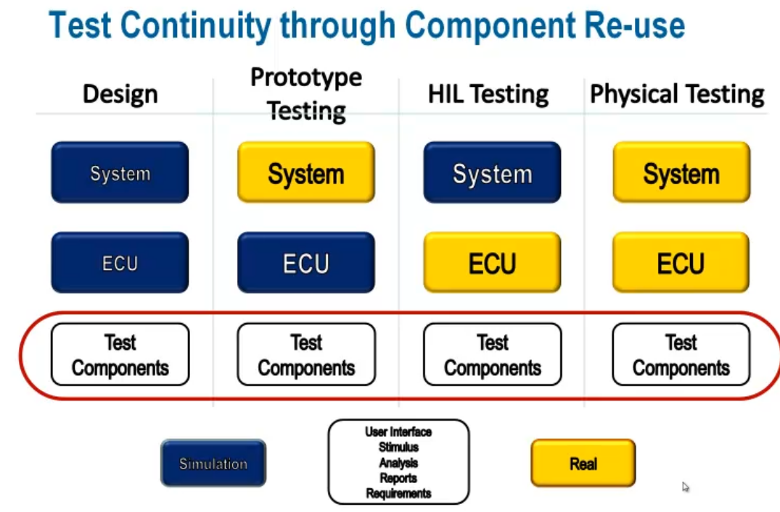
Test components reuse across all testing applications can increase consistency and efficiency throughout the process.

Slide 23
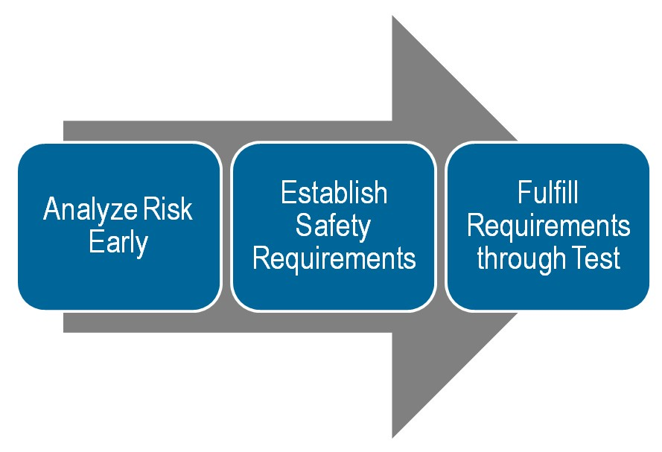
Applying ISO26262 to Current Processes
It is important for companies looking to implement ISO26262 to understand that the goal is to analyze risk early in the development process, establish the appropriate safety requirements, and fulfill these requirements by testing during development.

Slide 24
It is estimated that the cost of a failure decreases by 10 times when the error is caught in production instead of in the field and decreases 10 times again if it is caught in design instead of production.
Tool Confidence Level (TCL):
The possibility of a malfunctioning software tool and its erroneous output can lead to the violation of any safety requirement allocated to the safety-related item or element to be developed.
The probability of preventing or detecting such errors in its output.
Software Tool Classification Analysis:
Software Tool Classification Analysis (STCA) is to determine the Tool’s Confidence Level.
There are two main components that determine the TCL: Tool Impact (TI) and Tool Error Detection (TD). Based on these two components, the appropriate TCL is chosen.

Slide 25
ISO 26262 Safety Mechanism Insertion And Validation An automated workflow using safety synthesis and formal verification can help address random faults with safety mechanisms.
Automotive ICs have become too large and complex to expect a human to fully comprehend the safety mechanisms required to protect all possible failures. An automated workflow must be deployed to assist experts in addressing random faults. An efficient approach is to use safety synthesis and formal verification to incorporate safety mechanisms into the design. This is best to be done at the register transfer level (RTL), where functional verification can be performed efficiently.
The process can consist of these major steps:

Slide 26
Safety Exploration:
The goal of safety exploration is to identify optimal safety architecture and safety mechanisms. Safety mechanisms come in a variety of flavors, each with its own level of effectiveness in detecting random hardware faults. During safety exploration, a series of “what-if” scenarios are performed to understand the impact of different safety mechanisms on the design, especially with respect to power, area, performance, safety metrics, and diagnostic coverage. We recommend this exploration be done without modifying the design so that simultaneous analyses can be performed quickly and efficiently. If this is performed early in the design process, safety exploration will help design teams meet the safety targets successfully after insertion and verification.

Slide 27
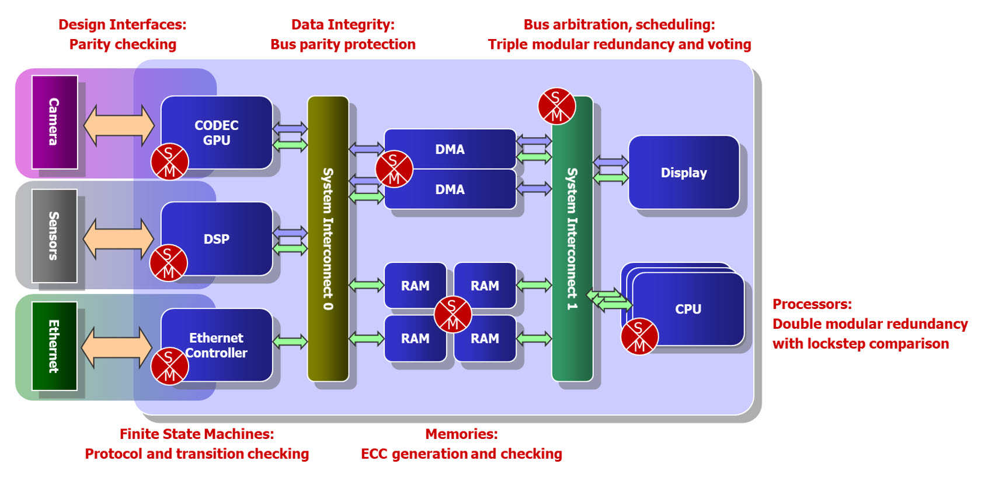
Safety Mechanism Insertion:
Modifying a legacy design to introduce safety mechanisms. Use safety synthesis to introduce safety mechanisms that have the right tradeoff for the RTL structures. To create a safety architecture for legacy designs, safety synthesis introduces two types of safety mechanisms automatically. One is used at the register level, and the other is used at the module level.

Slide 28
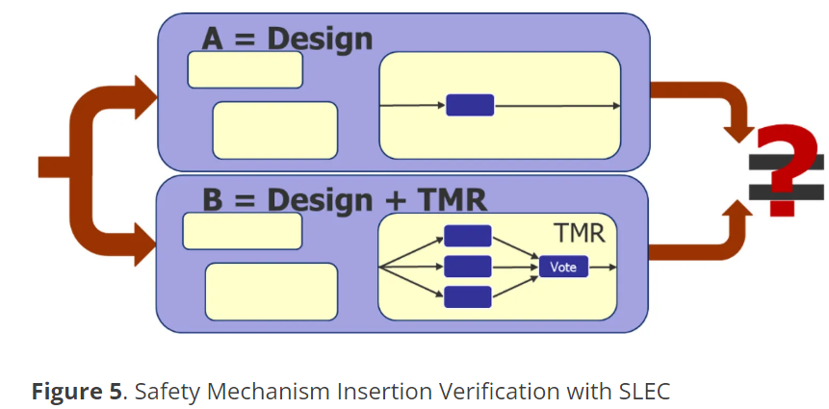
Design Change Validation:
Validate the design changes with formal verification. Sequential Logic Equivalence Checking (SLEC) formally verifies that two designs are functionally equivalent using formal verification technology.
Safety Mechanism Insertion: ensures that the functionality of the original design is not changed by the addition of the safety mechanisms
Safety Mechanism Operation: ensures that the inserted functional safety mechanisms are working as

Slide 29
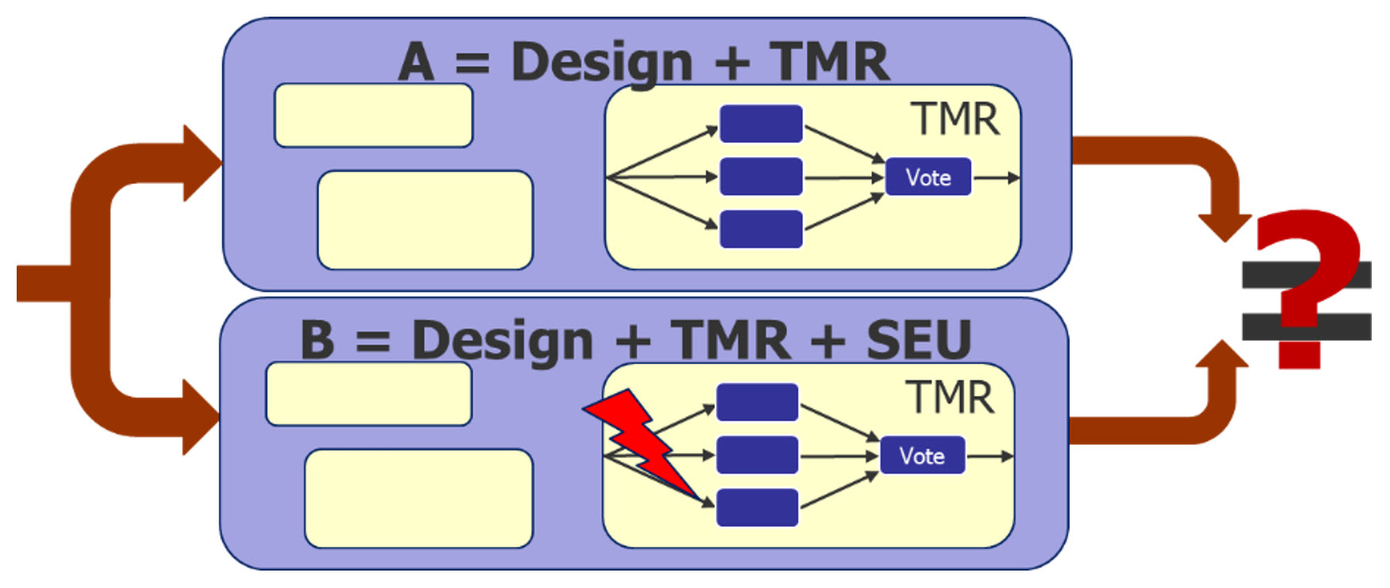
Formal Fault Injection:
Perform formal fault injection to measure the diagnostic coverage.
By comparing a fault-injected design with a copy of itself without faults, the formal tool checks if there is any possible way for a fault to either escape to the outputs or go undetected by the safety mechanism.
see if the fault is propagated,
masked, or detected by the
safety mechanisms.

Slide 30
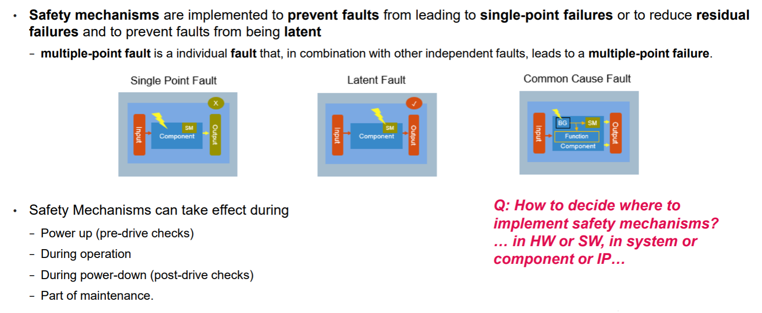

Slide 31
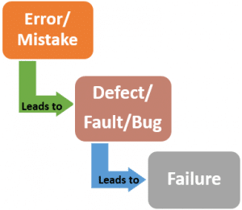
Falt Transfers From Error -> Fault -> Failure Levels for MCU
The process of how faults transfer from Error -> Fault -> Failure levels for
MCU (Microcontroller Unit) can be explained as follows:
Error:
An error is a human action that produces an incorrect or unexpected result.
Errors can occur during the design, development, or testing phase of a product.
Fault:
A fault is a defect in the hardware or software that causes the system to behave in an unintended way.
Faults can be caused by manufacturing defects, design errors, or environmental factors.
Failure:
A failure is the inability of a system to perform its intended function.
Failures can be caused by faults that are not detected or corrected.
Failures can occur during the normal operation of the system or during a safety-critical event.
The process of how faults transfer from Error -> Fault -> Failure levels for MCU is important for functional safety verification. Functional safety verification explicitly models faulty behaviors caused by random defects and verifies that the safety mechanisms built into safety-critical systems can detect and mitigate these faults. Verification tools must inject faults and verify that the safety mechanisms can detect them

Slide 32
FAILURE MODE AND EFFECTS ANALYSIS (FMEA)
Failure modes and effects analysis (FMEA) is a step-by-step approach for identifying all possible failures in a design, a manufacturing or assembly process, or a product or service.
"Failure modes" means the ways, or modes, in which something might fail. Failures are any errors or defects, especially ones that affect the customer and can be potential or actual.
"Effects analysis" refers to studying the consequences of those failures.
Failures are prioritized according to how serious their consequences are, how frequently they occur, and how easily they can be detected. The purpose of the FMEA is to take actions to eliminate or reduce failures, starting with the highest-priority ones. FMEA is used during design to prevent failures. FMEA begins during the earliest conceptual stages of design and continues throughout the product or service’s life.

Slide 33
FMEA involves the creation of a list of all failure modes, with each often being presented in a table with seven columns, as follows:
1. List of potential failure modes
2. Effect of the failure
3. Severity of the failure (on a scale of 1-10, from a minor risk to a critical risk)
4. Root causes for the failure
5. Likelihood of failure occurring (on a scale of 1-10, from extremely unlikely to inevitable)
6. Likelihood of detection (on a scale of 1-10, from extremely likely to extremely unlikely)
7. Risk priority number (RPN), created by multiplying the severity, likelihood of occurrence, and likelihood of detection numbers together. The higher the RPN, the more critical the failure

Slide 34
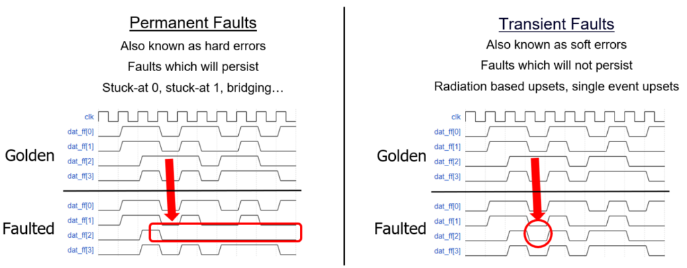
Permanent v/s Transient Fault
A permanent fault is one that continues to exist until the faulty component is repaired. Permanent faults are faults that are not detected and can have devastating effects.
The transient fault occurs only once and we cannot trace it later on. If we repeat the operation, the fault goes away. The transient fault occurs in a moment and leads to an error if not detected.

Slide 35
Design failure mode and effect analysis (DFMEA)
As mentioned above, DFMEA, also known as Design FMEA, stands for Design Failure Mode Effects Analysis and is used to identify potential failures in product designs during development.
Similar to regular FMEA, DFMEA requires all potential failure modes to be listed along with their effects and a corresponding severity rating.
The DFMEA process can be broken down into ten steps, as follows:
1. Design Review: Assess the part in relation to the product and other parts to determine its expected function
2. Identify Potential Failure Modes: Identify and list the ways in which the part could fail
3. Identify Potential Failure Effects: List the effects of the identified failure modes
4. Identify Potential Causes of Failure: List the design elements that contribute to the potential failures
5. Assign a Severity Rating: Determine a severity rating from 1-10, with one equalling low risk and ten equalling a high level of severity should the failure occur
6. Assign an Occurrence Rating: Determine a rating for the chance of the failure occurring from 1-10, with one being very unlikely and ten being extremely likely or inevitable
7. Assign a Detection Rating: Assign a detection ranking between 1 and 10, with one being a failure that is easy to detect and ten being one that is extremely difficult to detect.

Slide 36
8. Calculate a Risk Priority Number (RPN): Multiply the severity rating by the occurrence rating and the detection rating to create an RPN of between 1 and 1,000, with one being low risk and one thousand being a very high risk
9. Create an Action Plan: Develop a plan of action based on the RPN to decrease the chance and the impact of any potential failures
10. Recalculate the Risk Priority Number: Recalculate the RPN to measure improvements once failure control measures have been put into action
One of the major advantages of DFMEA is cost-saving. It is far less expensive and time-consuming to correct a defect earlier on in the product lifecycle, with the design stage being the easiest and cheapest at which to correct any potential failures. DFMEA tends to be used mainly for products, while FMEA can also be used for processes, procedures, and services.
 | FMEA | DFMEA
Definition | Failure Mode Effects Analysis | Design Failure Mode Effects Analysis
Areas of Use | Used in manufacturing and engineering | A type of FMEA, mainly used for product design
Stage of Use | Used from design through to end-of-life for products, processes, and services. | Used in the design stage only.

Slide 37
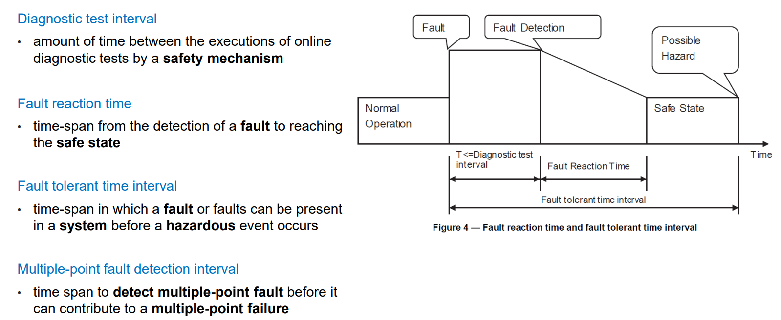
Fault Detection & Reaction Times

Slide 38
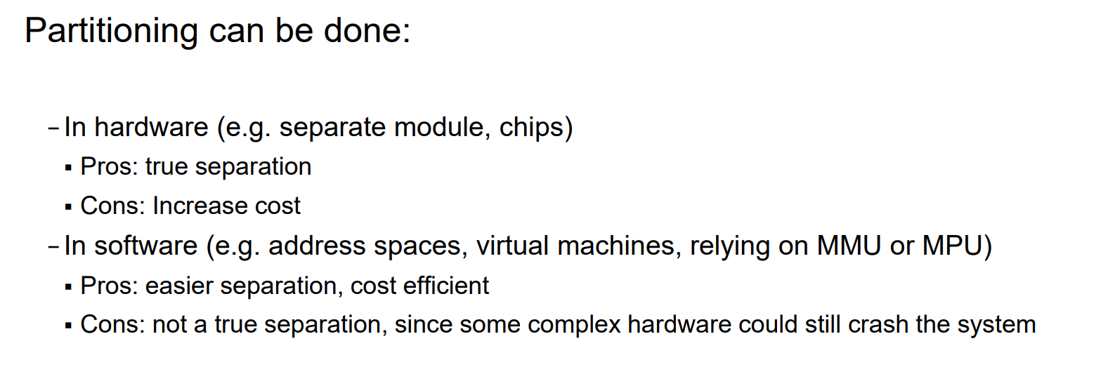
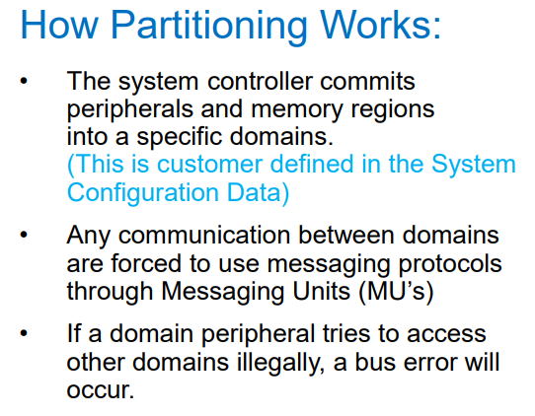
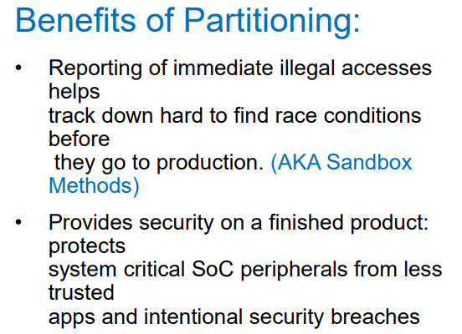
Partitioning A Safety Critical System

Slide 39
Functional Verification v/s Functional Safety verification.
Functional Verification and Functional Safety Verification are two different concepts. Here are the differences between them:
Functional Verification: The process of verifying that a design meets its functional requirements.
Ensures that the design behaves as intended and meets the specifications.
Focuses on verifying the functionality of the design.
Involves testing, simulation, and debugging.
Used to identify and fix design bugs.
Functional Safety Verification: The process of verifying that a safety-critical system meets its safety requirements.
Ensures that the system is safe to use and meets the safety standards.
Focuses on verifying the safety mechanisms of the system.
Involves testing, simulation, and analysis.
Used to identify and fix safety hazards.
In summary, functional verification is focused on verifying the functionality of a design, while functional safety verification is focused on verifying the safety mechanisms of a safety-critical system.

Slide 40
FORMAL VERIFICATION AND SIMULATION
Formal verification is an approach to verification that analyzes a design to prove or disprove certain properties.
ex: Verifying a behavioral ALU design using gate-level implementation Usually limited to small designs or verifying certain key properties
A simulation is an approach where we create a model of the design that can be executed on a computer and provide inputs and check that outputs of the model match the expectations.
Simulation has several advantages like excellent controllability and observability.
Simulation has also several disadvantages and perhaps the most important one is it's extremely slow compared to execution on physical implementation(emulation).
EMULATION
"Emulation is the technique whereby the design is transformed into an implementation capable of being executed on special purpose hardware” Emulator is a physical device onto which a system can be mapped relatively quickly (in hours or days) and which can be placed into the system's real eventual environment.
Emulator has a number of blocks capable of taking on a function (such as tens of FPGAs) and a programmable interconnect. Emulator also has a software toolchain that configures the interconnect and provides runtime env that makes the emulator look similar to the simulator
An emulator can either be connected to a testbench or another part of the circuit running in a logic simulator. This is called co-emulation or simulation acceleration.
These support designers to debug tasks such as stopping execution and viewing the internal values.
Since an emulator is a physical implementation, it is typically much faster than a simulation.
Since the environment isn't modeled here, an incomplete environment is not a problem as well.
Field Programmable Gate Arrays (FPGAs) are integrated circuits often sold off the shelf. They're referred to as 'field programmable' because they provide customers the ability to reconfigure the hardware to meet specific use case requirements after the manufacturing process.

Slide 41
Functional verification:
Functional verification is the process of demonstrating the functional correctness of an RTL design with respect to the design specifications. Functional verification attempts to check whether the proposed design is doing what it is intended to do. This is a complex task and takes the majority of time and effort in most large electronic system design projects. It is imperative that the design is functionally verified and any potential bug is eliminated at an early stage.
Validation:
While pre-silicon verification runs the test cases on the design on the simulator, post-silicon validation is executed on a few initial hardware prototypes of the design on the silicon chip in a real environment. This process captures the bugs that are escaped during the RTL Design Verification phase. Validation also checks for the correctness of the design but on the real hardware in an actual working ambiance.

Slide 42
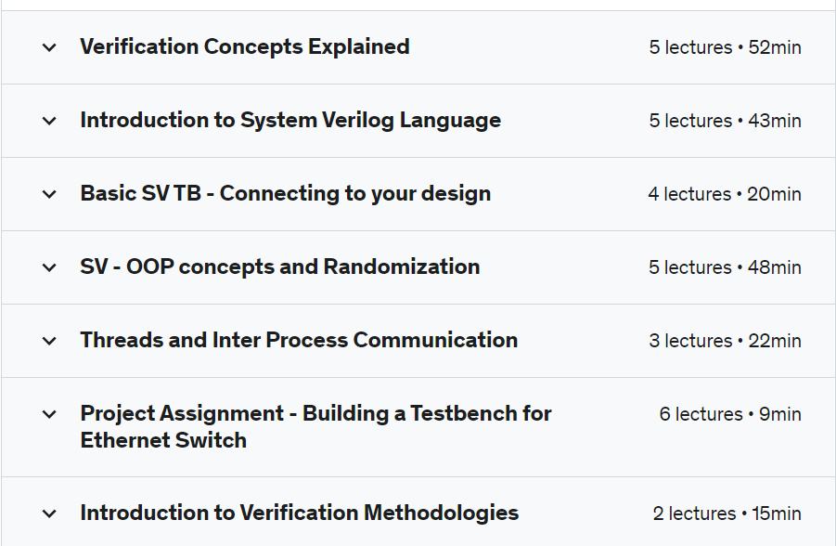
SOC Verification using SystemVerilog
https://www.udemy.com/course/soc-verification-systemverilog/

Slide 43
I2C Communication Protocol
I2C stands for Inter-Integrated Circuit. The I2C bus is a very popular and powerful bus used for communication between a master (or multiple masters) and a single or multiple slave device.
It uses only 2 bi-directional open-drain lines for data communication called SDA and SCL. Both these lines are pulled high.
Serial Data (SDA) – Transfer of data takes place through this pin. Serial Clock (SCL) – It carries the clock signal.
I2C operates in 2 modes – 1. Master mode, 2. Slave mode
Each data bit transferred on the SDA line is synchronized by a high to the low pulse of each clock on the SCL line. The data is transmitted in the form of packets which comprises 9 bits. The sequence of these bits is –
Start Condition – 1 bit
Slave Address – 8 bit
Acknowledge – 1 bit

Slide 44
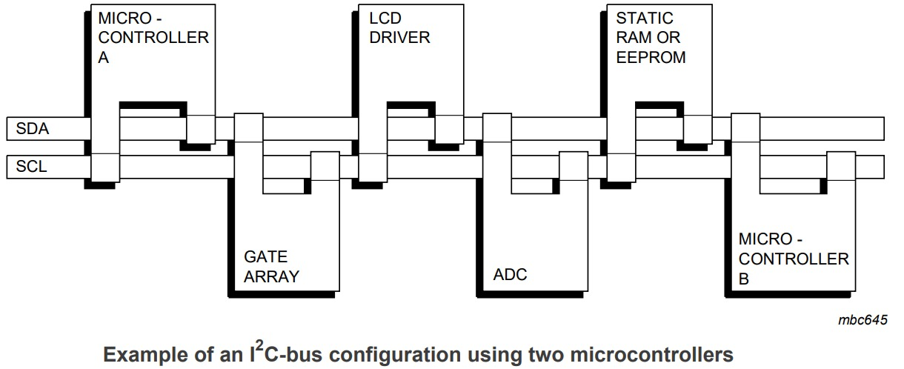

Slide 45
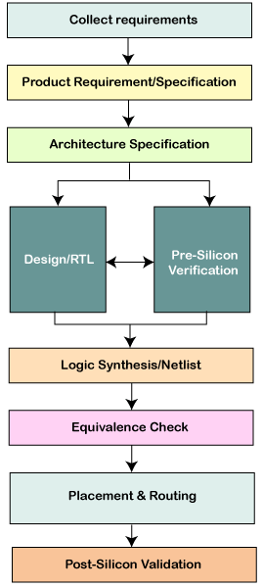
Design Flow

Slide 46
TO-DO: more things to include
What is Functional Safety?
Why do we need Functional Safety?
Diffrence between Functional Verification and Functional Safety verification.
(Functional safety verification is more of formal verification)
Use of Functional Safety (specify for all ASIL (A - D) ASIL-D must)
How falt transfers from Error -> Fault -> Failure levels for MCU. Specify these 3 modes.
In these 3 modes, we traverse from error to fault to failure to check how the fault is spreading across the system then we backtrack from failure mode to error mode.
FMA, DFMEA, DFMDEA
Study Design Sync for version control like GitHub.

Slide 47
